Slide 1

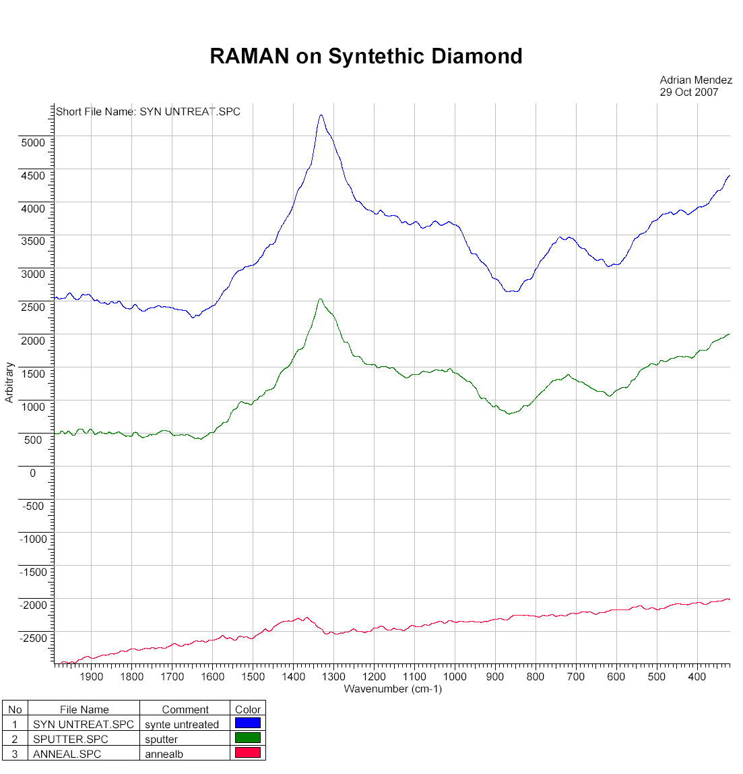
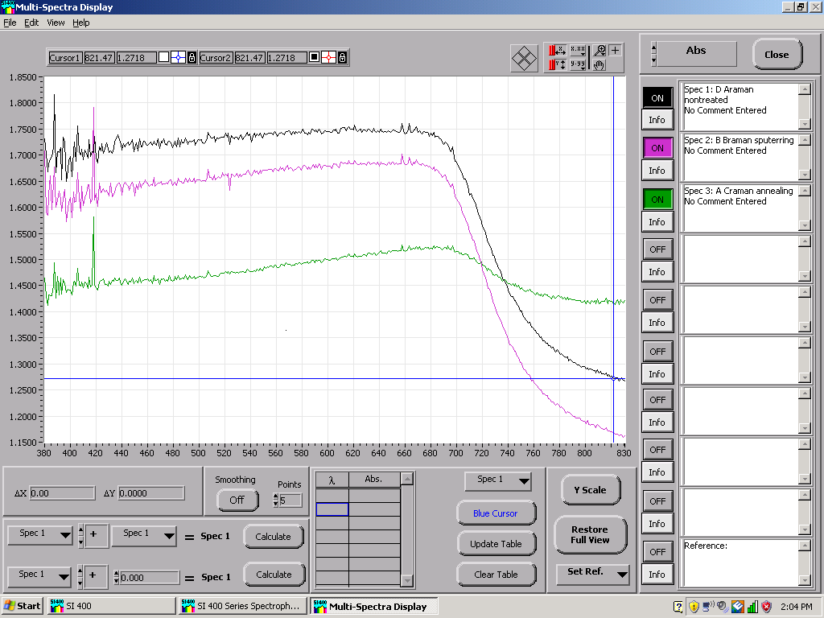



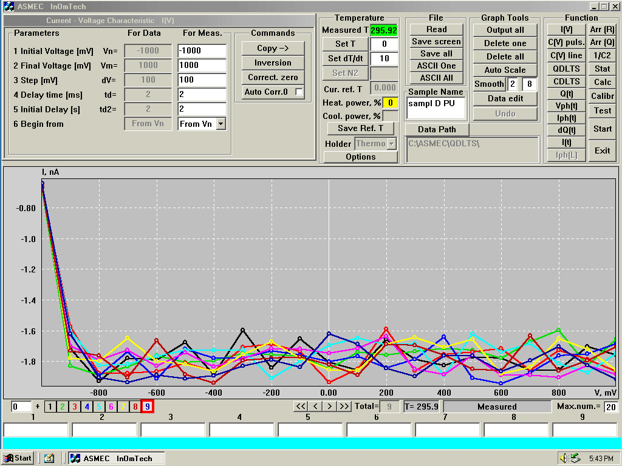
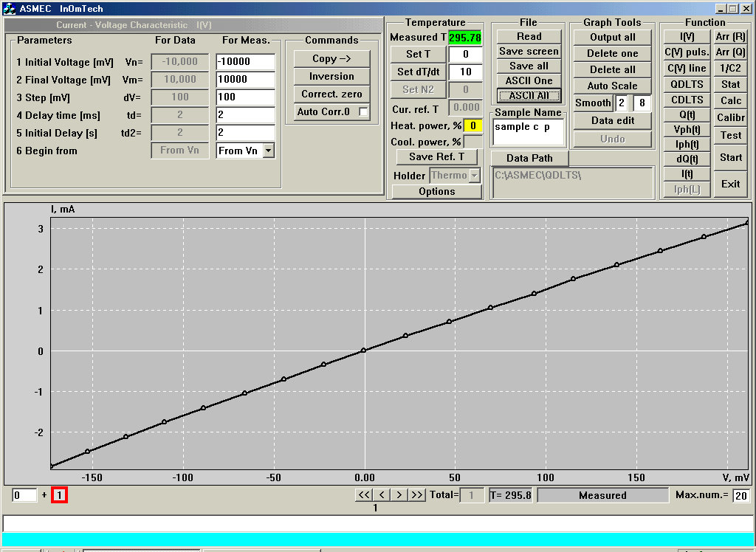
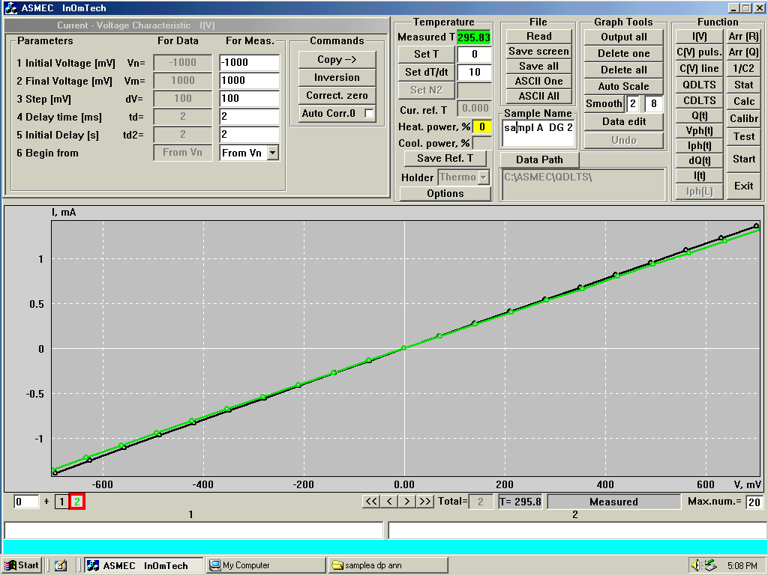
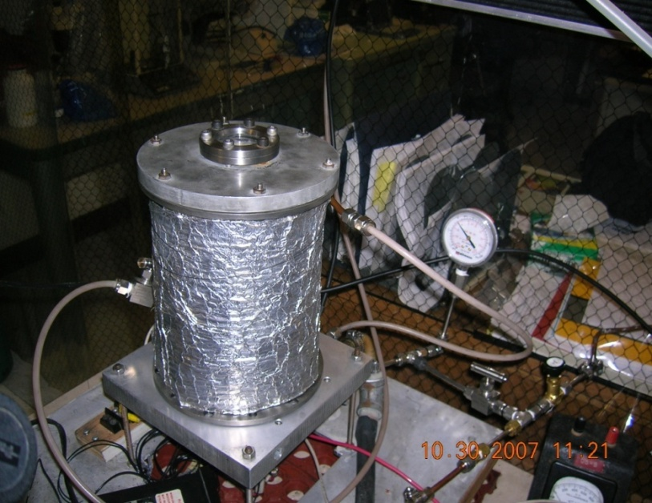
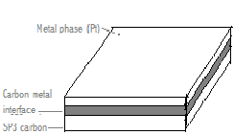
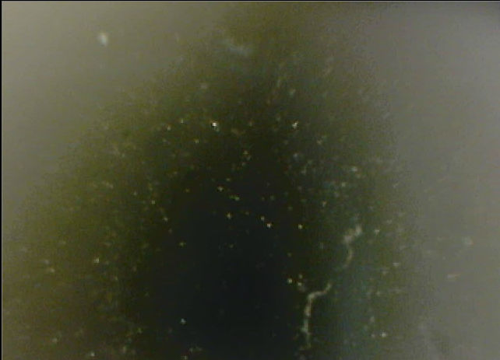
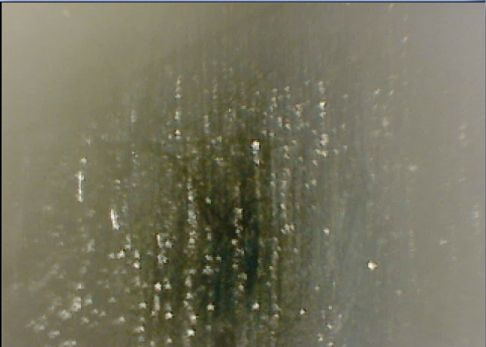
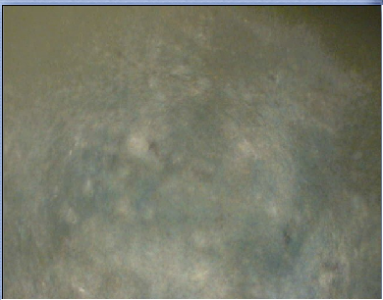
Platinum deposition on Sp³-bond Carbon: Applications in corrosive environments and catalyst support material
Y. M Suárez, A. Méndez, M. Prelas, T. Ghosh
Nuclear Science and Engineering Institute, University of Missouri-Columbia
MOTIVATION
EXPERIMENTAL RESULTS
CONCLUSIONS
Study the properties of SP3 carbon as support materials for chemical process. The improvement of materials used for l catalysis
The need of material suitable for the H production using the proposed high temperature nuclear reactors
Study the corrosion properties of the Pt-Sp3 carbon system to used develop materials that can operate in extreme conditions
Raman spectroscopy
UV-Vis (DRUV-VIS)
In Raman spectroscopy the intensity of peak (1331.29 cm⁻¹) move from 1331.29 cm⁻¹ to 1366.48 cm⁻¹. This peak change is characteristic of the annealing at high temperatures, related to Pt/diamond, and its intensity decrease.
The decrease of the current and voltage (QDL:TS) between after and before the annealing is the results of diffusion of Pt on diamond.
In the QDLTS the samples reveals linear response in both cases after sputtering and annealing from nA to mA and voltage between ± 10 volts.
The samples show that the process of sputtering was homogeneous, and the case of C meaning that the annealing at low temperature was uniform.
The UV-VIS confirms the previous results because the slope for sample C with annealing is smoother (fig. UV-VIS “A, C Raman annealing”) than the samples of single diamond and pt/diamond.
The intensity peak 418cm⁻¹ correspond nitrogen with results of sputtering conditions. This research confirms that the Pt/diamond annealing behaves uniformly under low temperatures, and diamond corrosion can be minimized under these conditions.
The annealing, even when is conducted at moderately low temperature process creates a more stable adhesion by the formation of a carbon-metal interface with the diamond.
ABSTRACT
Sp³ carbon possess several properties such as highest thermal conductivity, resistance to corrosion, and toughness to radiation, that make Sp³ carbon desirable for the development of materials that can operate in harsh environment.
Corrosion resistant carbons, such as diamond, are promising materials in several fields such as: Electron emission devices, Fuel cells, Hydrogen storage, Catalytic electrodes
Metal-Diamond base materials (Me:Db) can be used as support a material for catalysis (i.e. catalytic electrodes), and can enhance the oxidation resistance properties of diamond when it is combined at elevated temperatures.
Diamond offer several advantages over carbon (sp2 – bonded) electrodes, such as activated carbon, carbon black, and graphitized carbon. Sp³ – bonded carbon, namely diamond, is corrosion resistant and offers structural stability.
In contrast Sp ² – bonded carbon is susceptible to corrosion and micro structural degradation during anodic polarization (J. Wiang, 2002).
Studies also show that modified diamond supported catalysts exhibited higher catalytic activity when compare to activated carbon-supported catalysts (Kiyuharu, 2002).
IV-QDLTS
FUTURE WORK
The samples will be further characterize by FTIR and SEM/EDS.
The samples will be exposed in a sulfuric acid decomposer system developed at the University of Missouri-Columbia to test the corrosion rate of the treated samples, others metals are also going to studied, and the conditions to sputtering and annealing process will be changing.
Additional effort is going to be made to study the catalytic properties of the Me:DB materials.
METHODOLOGY
Three samples of polycrystalline synthetic diamond films have been prepared with a thin film of Pt deposited on the surface by magnetron sputtering.
Different thicknesses, which range from .1 nm to 3 nm, have been deposited over the surface of the samples.
The coated samples where annealed in a cold wall reactor in an inert environment at temperature of 500 C, for 8 hours.
Three samples of polycrystalline synthetic diamond were weighted on a digital balance and covered with a thin film of Pt deposited on the surface by magnetron sputtering.
Two of those samples (coated samples) were annealed inside a cold wall reactor for 8 hours in an inert environment at a temperature of 500 ⁰C.
After each process the samples were characterized using micro – Raman spectroscopy, UV-Vis (DRUV-VIS), I-V and QDLTS.
The two coated samples were compared with the non-coated to verify if the annealing process occurred at lower temperatures previously done in other research.
Sample B. Diamond with sputtering
REFERENCES
Sample A. Diamond untreated
[1] Kiyoharu N., Takayuki , H,. Chiaki , K. , Na-okhi , I., Testsuhiko, K., Mikka , N. , Toshimitsu , S., and Toshihiro, A. Diamond-Supported metal catalysis: a novel medium for hydrogen production from methanol decomposition. Catalysis letters Vol. 80, No. 3-4, June (2002).
[2] Wang, J. and Swain, G.M. Fabrication and Evaluation of Platinum’ Diamond Composite Electrodes for Electro catalysis. Journal of the Electrochemical Society, 150 (1) E24-E32 ~(2003).
[3] Mitani , S, Teraji, T., Ito, T. Formation of self-assembled platinum particles on diamond and their embedding in diamond by microwave plasma chemical vapor depositions. Diamond & Related Materials 15 (2006) 1544–1549
[4] Follador, R.C. , Minucci. M.A.S. , Toro, P.G.P., Trava-Airoldi. V.J. and, Ferreira., N.G. Preliminary study of CVD diamond film to improve the performance of heat flux sensors for hypersonic experiments. Diamond & Related Materials 14 (2005) 637–640.
Sample C. Annealing and Sputtering
Cold wall reactor
AKNOWLEDGEMENT
Raman main vibration peak (1331 cm-1) associated with Sp3 bonds is present on the treated samples.
I-V measurements (at room temperature) on the surface of the sample ,with variable currents from nano-ampere (nA) to mili ampere (mA) and voltage between ±10 volts, reveal linear response a positive slope.
It is assumed that the annealing process successfully creates a homogenous coating on the samples and increases the adhesion of the Pt to the diamond surface by the formation of a metal-carbon interface.
We would like to thank Jennis M. Vicente, Daniel E. Montenegro, Annie Yu-Ning Hsu, and the Nuclear Science and Engineering Institute.
Sample untreated
Sample treated
Sample with annealing

